Slide 1
PHISHING ATTACK INCIDENT IN REAL TIME
OR
ONLINE FINANCIALS SCAMS
CAPSTONE PROJECT
Presented By:
Abirami M
St Michael College of Engineering and Technology
Department of Computer Science and Engineering

Slide 2
OUTLINE
Problem Statement
Proposed System/Solution
System Development Approach (Technology Used)
Algorithm & Deployment
Result (Output Image)
Conclusion
Future Scope
References

Slide 3
Problem Statement
Example:
Examine a real-world case where a phishing attack compromised sensitive information in an organization. Discuss preventative measures and employee training programs to ensure the risks of social engineering attacks.

Slide 4
Proposed Solution
The proposed system aims to address the challenge of predicting the real-world case where a phishing attack compromised sensitive information in an organization. Discuss preventative measures and employee training programs to ensure the risks of social engineering attacks.
Employee Training Programs:
Regular training sessions to educate employees about the dangers of phishing attacks, how to recognize suspicious emails, and what actions to take if they suspect they've received a phishing email.
Encourage employees to promptly report any suspicious emails or activity to the IT security team. Establish clear procedures for reporting incidents and provide support for employees who may have inadvertently fallen victim to phishing attacks.
Email Filtering and. security software:
Implementing robust email filtering systems to automatically detect and quarantine suspicious emails before they reach employees' inboxes.
Deploy advanced threat protection software to analyze and block malicious attachments or links.
.Multi-Factor Authentication (MFA):
Requiring multi-factor authentication for accessing sensitive systems and data, which adds an extra layer of security even if credentials are compromised
.Developing a comprehensive incident response plan to quickly detect, contain, and mitigate the impact of a phishing attack if one occurs.
Regular Software Updates and Patch Management:
Ensuring all software and systems are regularly updated with the latest security patches to mitigate vulnerabilities that attackers may exploit
Limiting access to sensitive information based on the principle of least privilege, ensuring employees only have access to the information necessary for their roles.

Slide 5
System Approach
In a large financial institution, employees received an email purportedly from the IT department requesting them to update their login credentials due to a system upgrade. Unsuspecting employees clicked on the provided link and entered their credentials, unknowingly giving hackers access to sensitive financial data. This phishing attack compromised customer account information and led to financial losses for both the institution and its clients.
Implement robust email filtering systems that can identify and block phishing emails before they reach users' inboxes. This includes using techniques like SPF, DKIM, and DMARC to authenticate email senders.
Library required to build the model
python idle
pip install pynput
pip install json
keyboard library

Slide 6
Algorithm & Deployment
To prevent phishing attacks compromising sensitive information, you can employ a combination of algorithms and deployment strategies:
Algorithm Selection:
strong encryption algorithms like AES (Advanced Encryption Standard) to encrypt sensitive data. AES is widely adopted and considered secure.
Implement secure hashing algorithms such as SHA-256 to hash sensitive information. Hashing is vital for storing password securely.
Specify the input features used by the algorithm, such as historical bike rental data, weather conditions, day of the week, and any other relevant factors.
Employ digital signature algorithms like RSA or ECDSA to ensure the authenticity and integrity of sensitive communications. This helps in verifying the sender's identity and prevents tampering.
Training Process:
Train employees to identify common signs of phishing emails, such as misspelled URLs, suspicious attachments, urgent requests for personal information, and unfamiliar sender addresses.
Keep employees informed about the latest phishing techniques and trends. Reinforce training through periodic reminders, updates, and refresher courses.
Prediction Processi:
Continuous Monitoring: Implement continuous monitoring of network traffic and user behavior to detect any suspicious activity indicative of a phishing attack in progress.
User Verification: Encourage users to verify the legitimacy of requests for sensitive information through alternative means, such as contacting the purported sender through a known, trusted communication channel..

Slide 7
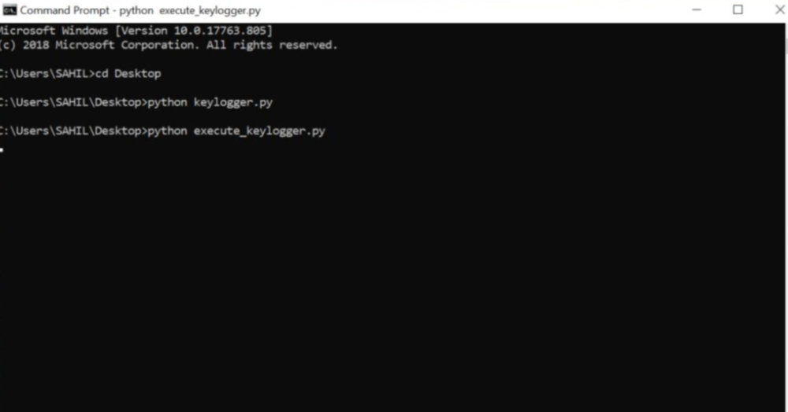

Slide 8
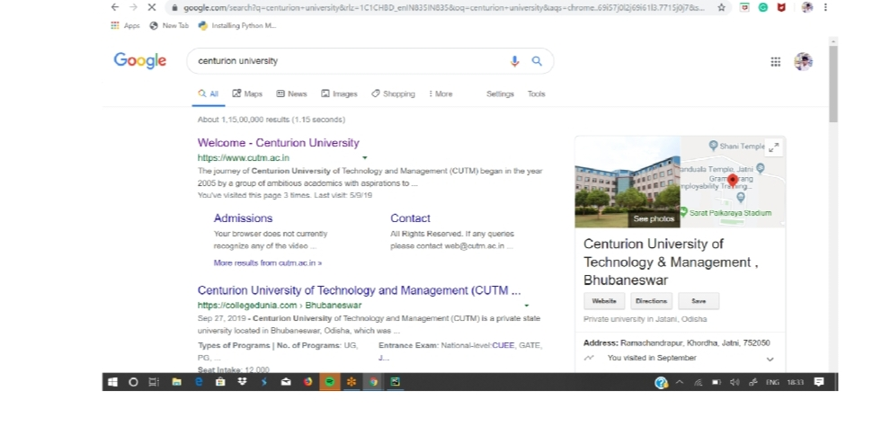
RESULT

Slide 9
Conclusion
Encryption plays a vital role in data security, but it's not a standalone solution against phishing and keylogging. A multi-layered approach that combines user awareness, robust authentication mechanisms, and potentially anti-keylogging software is more effective in safeguarding against these threats.

Slide 10
Future scope
Behavioral Biometrics:.Analyze typing patterns, mouse movements, and other user interactions to detect anomalies that might indicate a keylogger.
Hardware-based Security: Explore hardware solutions like Trusted Platform Modules (TPMs) that can provide a more secure root of trust for encryption
Machine Learning: Develop machine learning models to identify phishing attempts based on website characteristics, email content, and user behavior.
Usability Enhancements: Research ways to improve the user experience of encryption-based solutions, minimizing performance impact and complexity.

Slide 11
References
Phishing Information: https://en.wikipedia.org/wiki/Phishing
Two-Factor Authentication: https://en.wikipedia.org/wiki/Help:Two-factor_authentication
Virtual Keyboard Security: https://www.csoonline.com/network-security/
Browser Security Settings: https://support.google.com/chrome/?hl=en
Firefox: https://support.mozilla.org/en/products/firefox/privacy-and-security)

Slide 12
THANK YOU

